Slide 1
Abhivyakti website
Gusani Mansi

Slide 2
A Presentation On
Abhivyakti Website
is submitted in partial fulfillment of the requirement for the award of the degree
MASTER OF COMPUTER APPLICATIONS (INTEGRATED)
From
Gujarat Technological University
Mansi Gusani (175220686016)
Internal Guide
Dr. Sunil Bajeja
Marwadi Education Foundation’s Group of Institutions
(MEFGI)
Rajkot-Morbi Road, At & PO: Gauridad, Rajkot 360 003, Gujarat, India.

Slide 3
Index
SYNOPSIS
PREAMBLE
MODULES
TECHNICAL DESCRIPTION
SYSTEM DESIGN AND DEVELOPMENT
SYSTEM TESTING
SCREENSHOTS
CONCLUSION
BIBLIOGRAPHY

Slide 4
Synopsis

Slide 5
Abhivyakti is a website, which provides self-publishing and reading platform to the writers and the readers. Its features and functionality are provided in 3 languages: Gujarati, Hindi and English.
It allows users to publish and read original works such as stories, poetries, articles, essays, etc… It also allows readers to rate and to comment content posted by the others.
Through the Gmail Account multiple users can communicate with this website and they can share their ideas, greetings, suggestions with this website and the other users on this platform. This website provides good interface and connectivity to users. It is user friendly website and more convenient for the users.

Slide 6
Preamble

Slide 7
In this project, I have used PHP, HTML, CSS, JQUERY, AJAX and JAVA Script for creating attractive, more efficient, and extra ordinary website, and also I have used MySQL to create and manage the database. For creating logo and images, I have used Photoshop.
This project is designed with the goal of making the existing site more informative, reliable and secure for that users have to login in this site with valid Gmail ID and Password, then and then users are able to use this site for the various purposes such as creating profile, publishing contents, reading contents, participating in various competitions, etc….
I do my best to protect user’s privacy details and I make sure that I will not share any personally identifiable information with any third party. And the data transactions on the website are also secured.
In short, this is a great opportunity for transcript and a great platform for all people, from the perspective of writing to the world of reading-writing.

Slide 8
modules

Slide 9
There are mainly 6 modules which are included in this project: Home, Write, Search, Categories, Update and Profile.
Home:
It is a front layout of the website, which is connected with all the pages of different modules.
Write:
Writer can publish any content with the help of this module by following easy steps.
Search:
To find any content or author’s or poet’s name, this module is used.
Categories:
This module provides many classifications of the different contents: Suspense and Thriller, Romantic, Horror, Funny, Spiritual Stories, Science Fiction, Child Literature, Woman Special, Poems, Film and Music, Biography, Travel and Tourism, etc… Due to these classifications, readers can easily get any require content.
Update:
This module is used to display notifications and messages.
Profile:
This module is created to set personal information, maintain library, to keep the record of followers and following, to know the total reviews and rating.

Slide 10
Technical Description

Slide 11
Software Requirements:
Microsoft Windows 98, 7, Vista Or Higher Operating System
Google Chrome, Mozilla Firefox, Microsoft Edge
Any Editor (i.e. Notepad++, Notepad,…)
PHP 7.3.1
phpMyAdmin 4.9.1
Apache 2.4.41
Hardware Requirements:
512 MB RAM
Intel Pentium III Or Higher Processor
HDD 90 GB Or Higher

Slide 12
System design and development

Slide 13
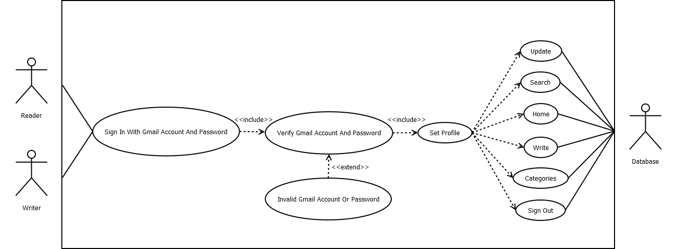
USE CASE DIAGRAM

Slide 14
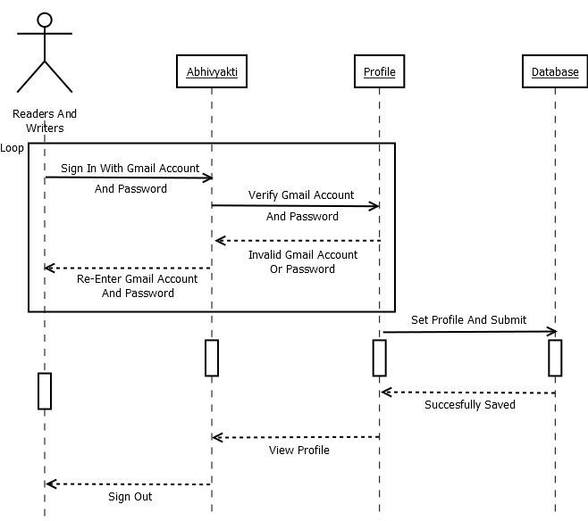
SEQUENCE DIAGRAM: SET THE PROFILE

Slide 15

SEQUENCE DIAGRAM: PUBLISH THE CONTENT

Slide 16
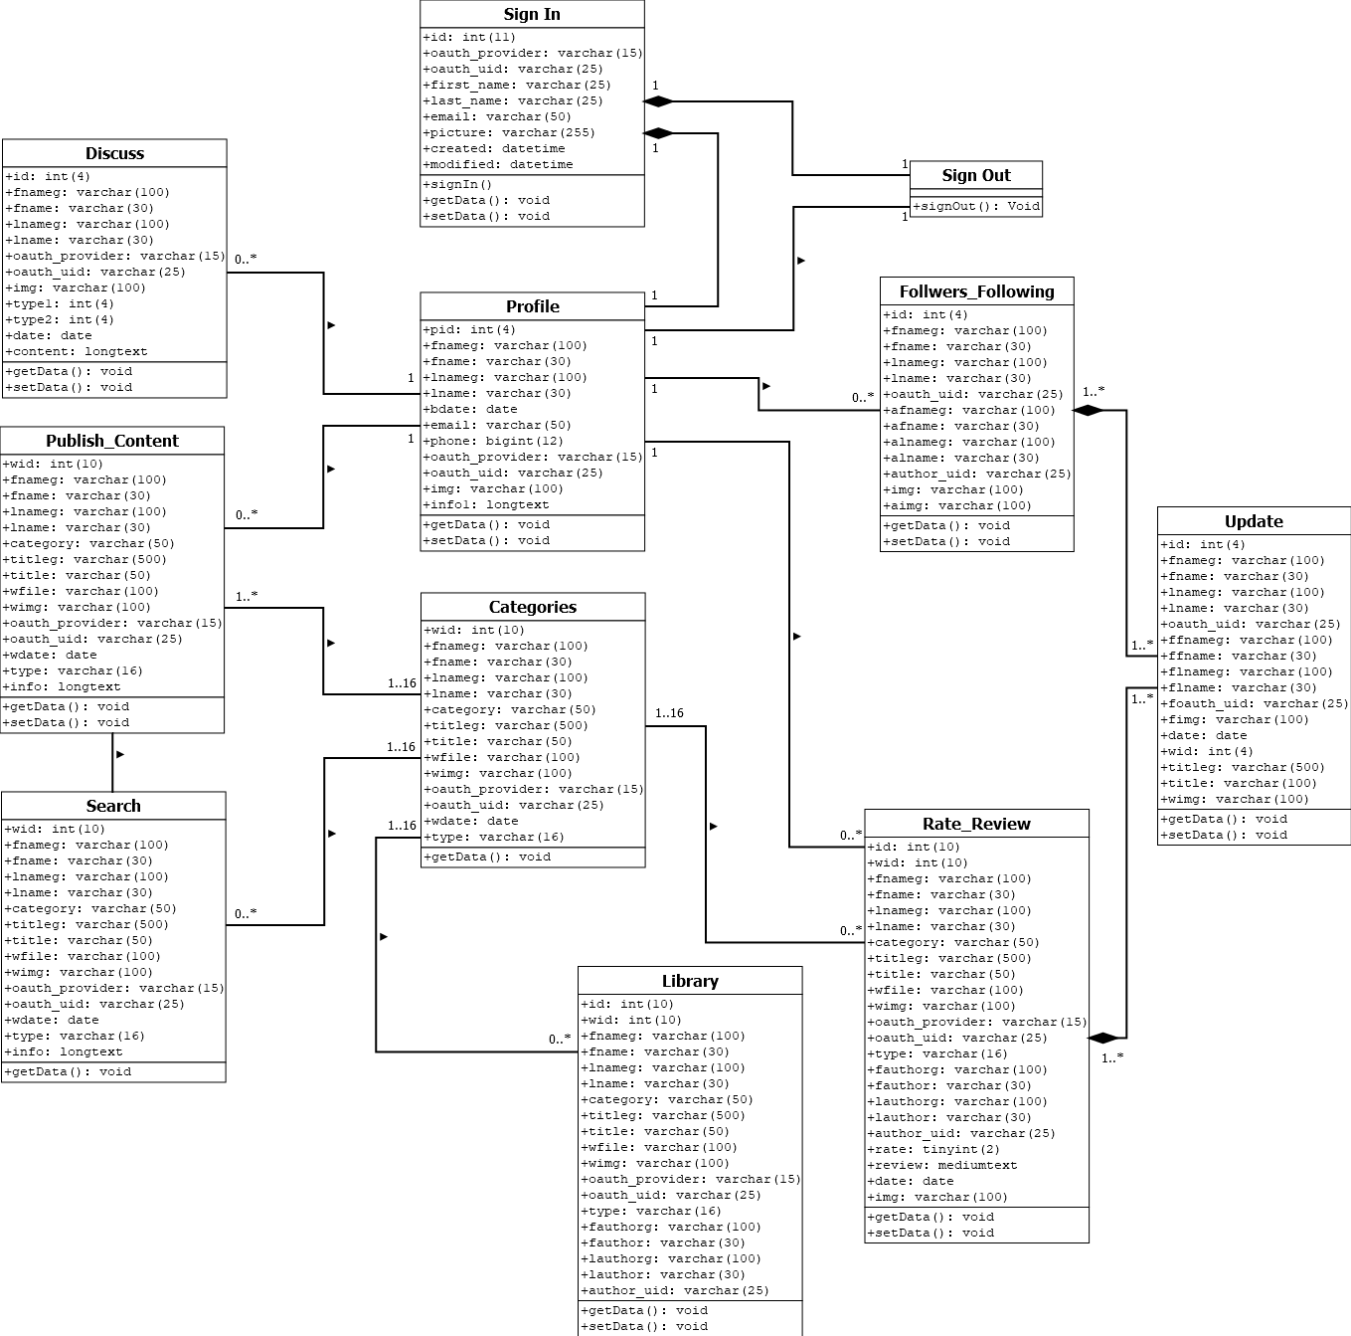
CLASS DIAGRAM

Slide 17
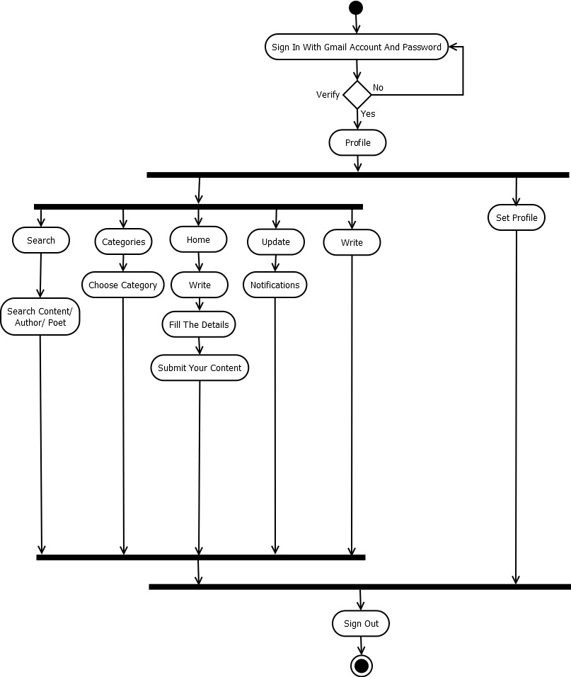
ACTIVITY DIAGRAM

Slide 18
System testing

Slide 19
No. | Test Case | Expected Output | Actual Output
1. | Sign In With Gmail Account And Password | Work Appropriately | Work Properly
2. | Create And Modify The Profile | Operations Work Perfectly | Expected Output
3. | Display All The Web Pages | Work Properly | Work Efficiently
4. | Publish The Contents | Work Appropriately | Work Efficiently
5. | Add And Remove The Contents From The Library | Perfectly Managed By Database | Expected Output
6. | Manage The Information Of Followers And Following | Perfectly Managed By Database | Work Appropriately
7. | Rating And Review Functionality | Perfectly Managed By Database | Expected Output
8. | Notification Messages | Work Appropriately | Work Efficiently
9. | All The Validations | Good Performance | Work Properly
10. | Database Connectivity | All The Queries Work Perfectly | Expected Output

Slide 20
Screen shots

Slide 21
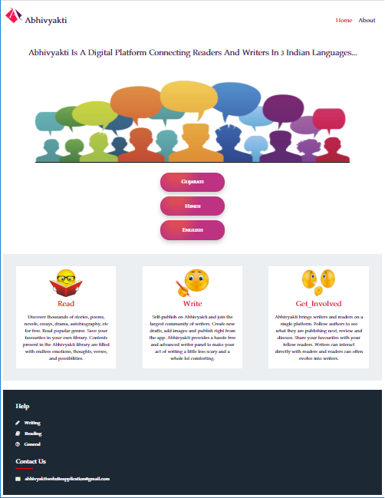
Index Page

Slide 22

About Us

Slide 23

Index Page – 1

Slide 24

Index Page – 2

Slide 25

Index Page – 3

Slide 26
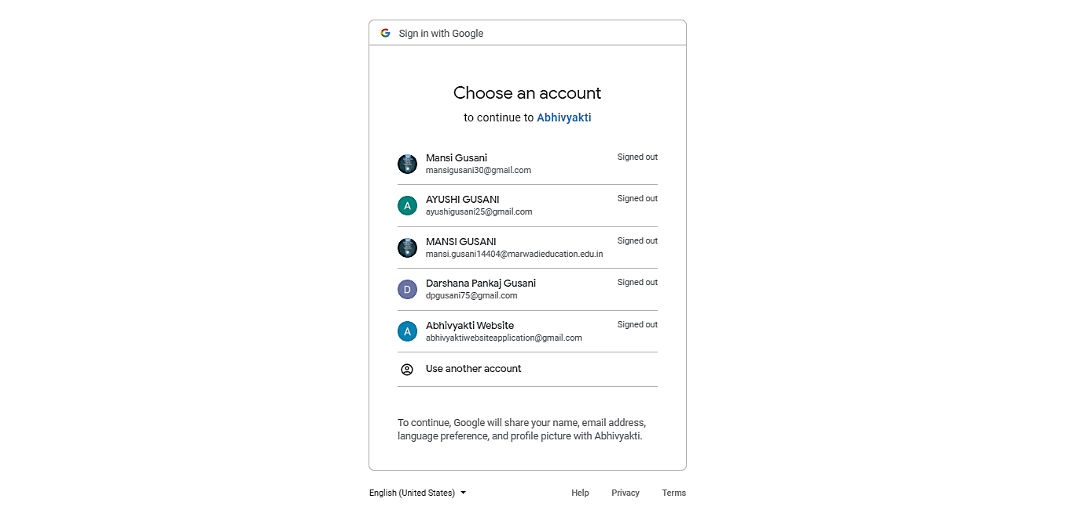
Google Sign-In – 1

Slide 27
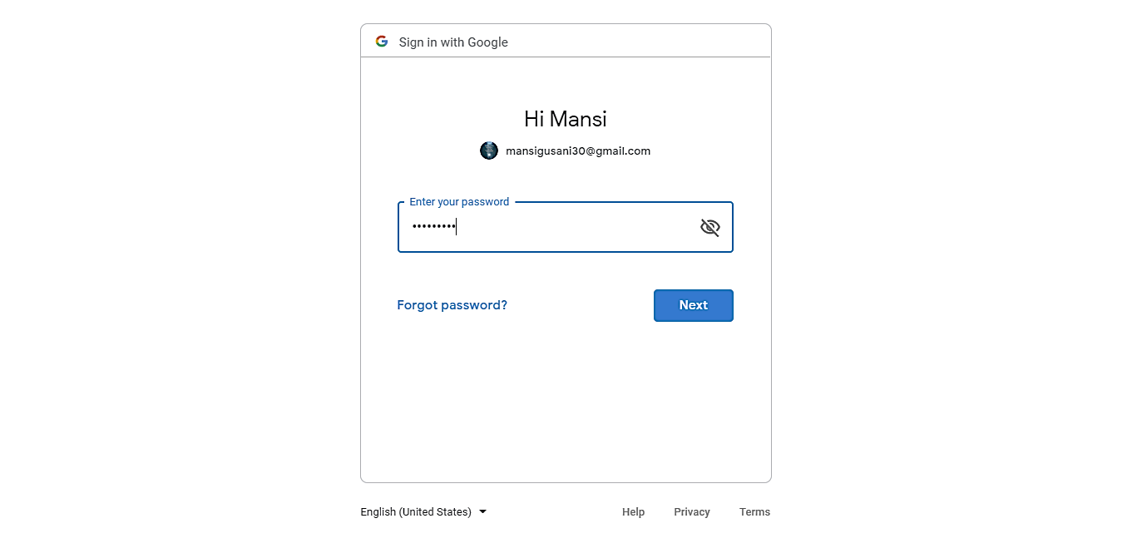
Google Sign-In – 2

Slide 28

Home Page – 1

Slide 29
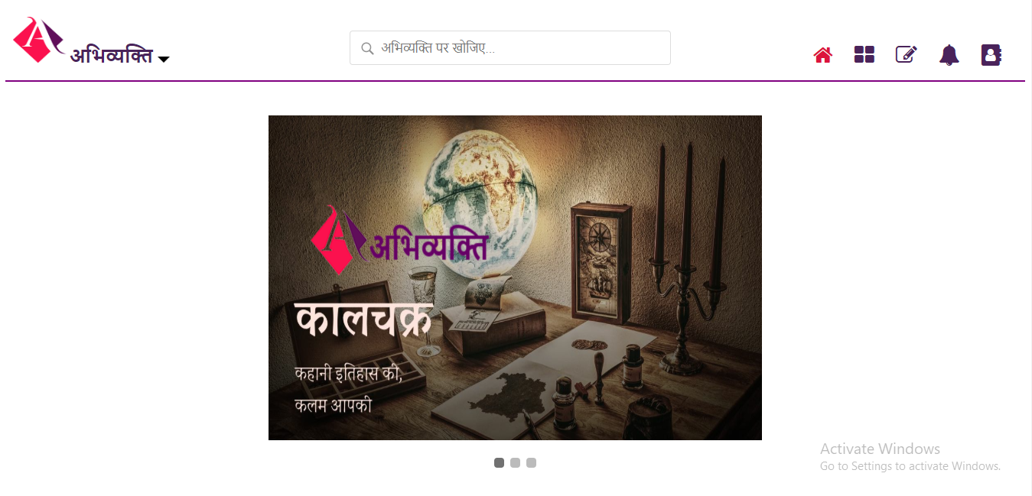
Home Page – 2

Slide 30
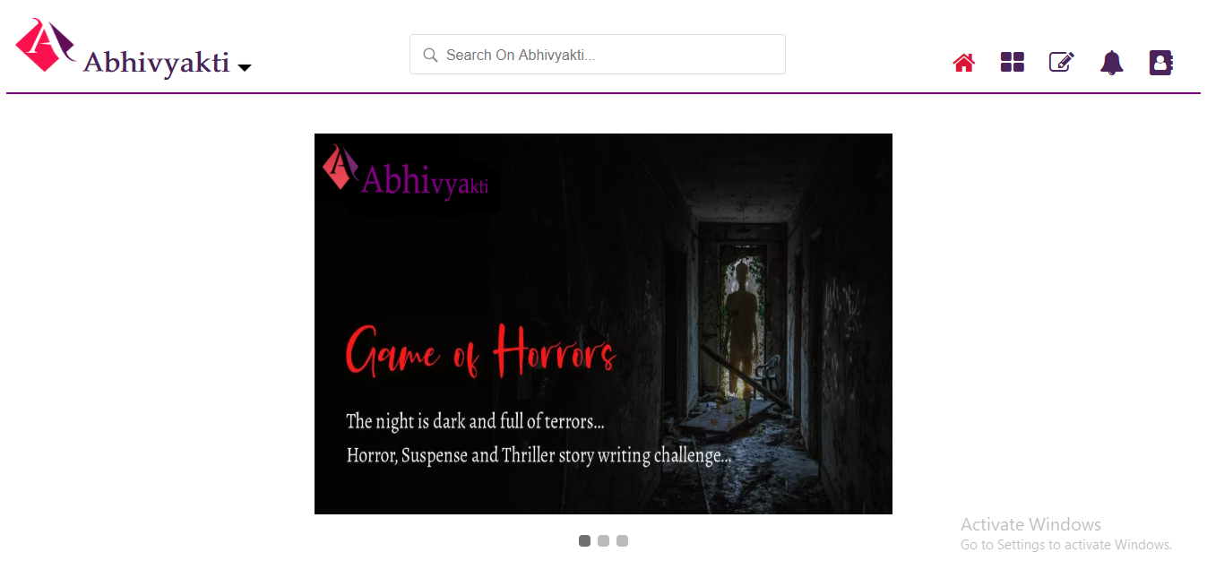
Home Page – 3

Slide 31

Categories – 1

Slide 32
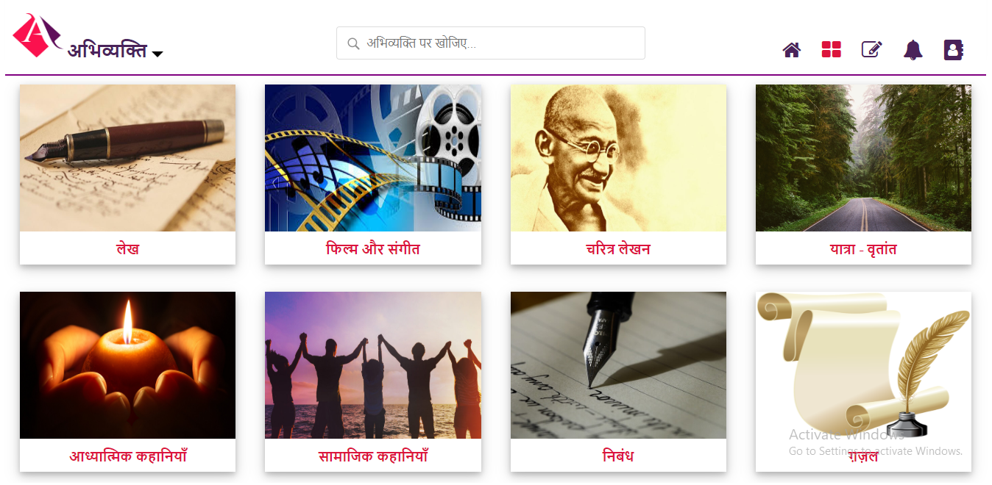
Categories – 2

Slide 33
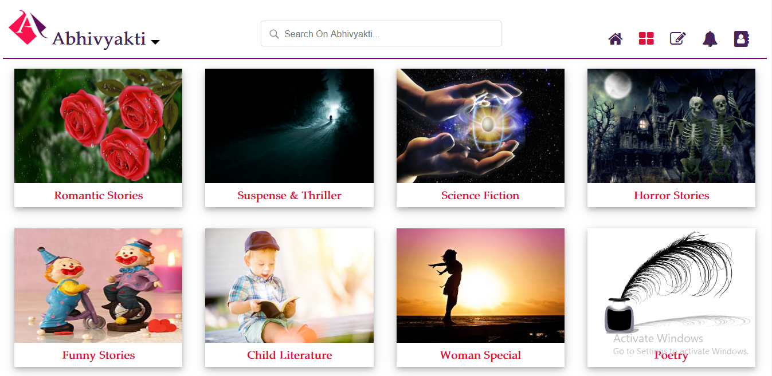
Categories – 3

Slide 34

Write – 1

Slide 35
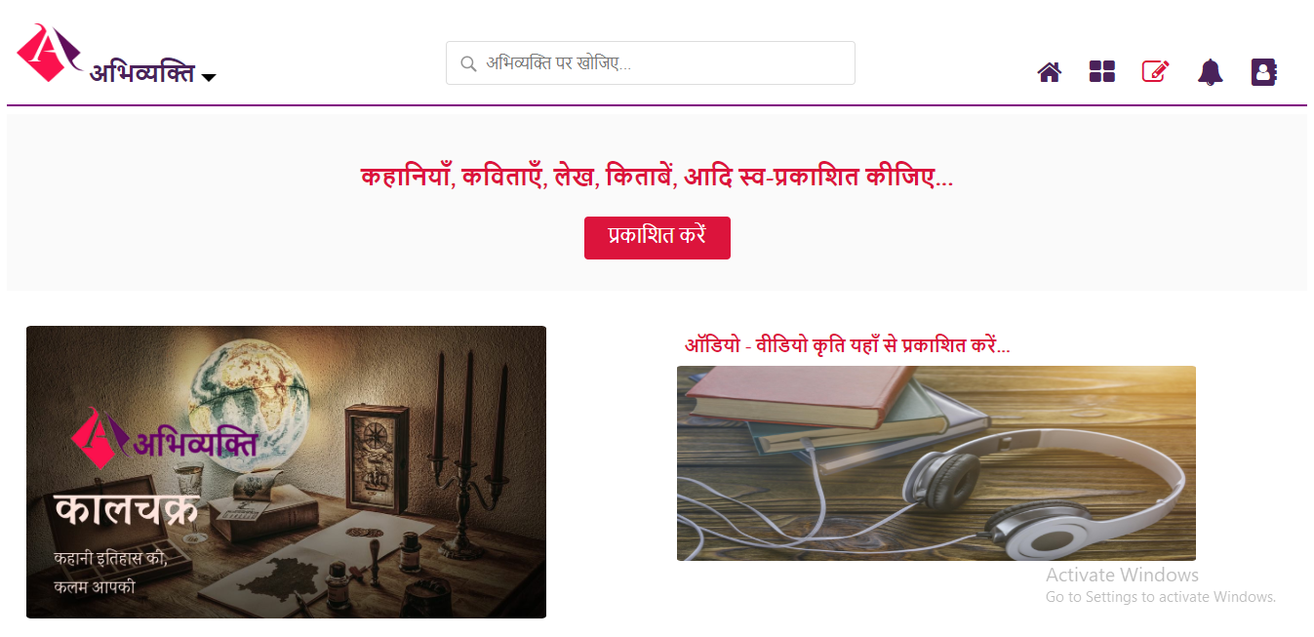
Write – 2

Slide 36

Write – 3

Slide 37
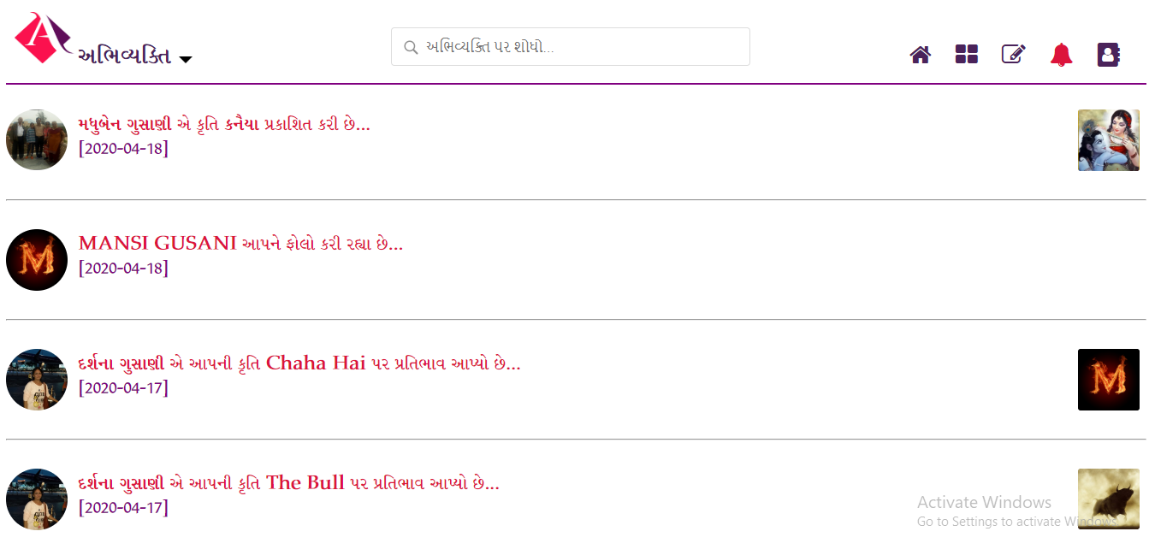
Update – 1

Slide 38
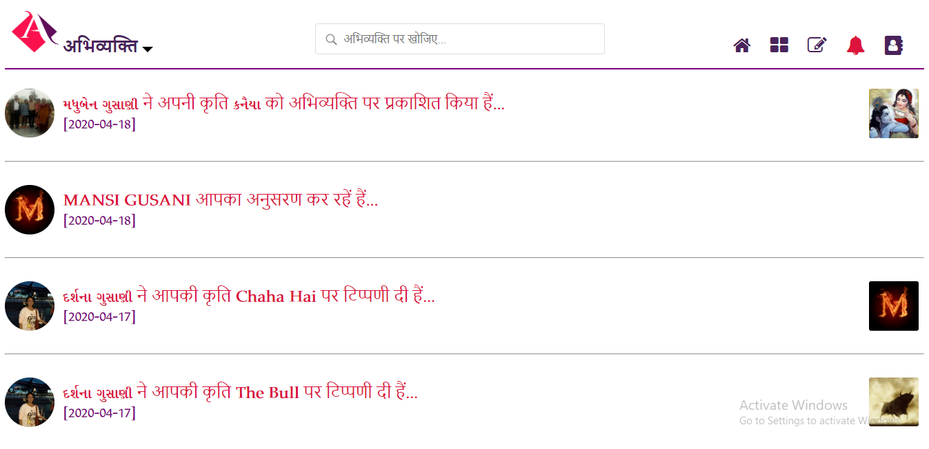
Update – 2

Slide 39
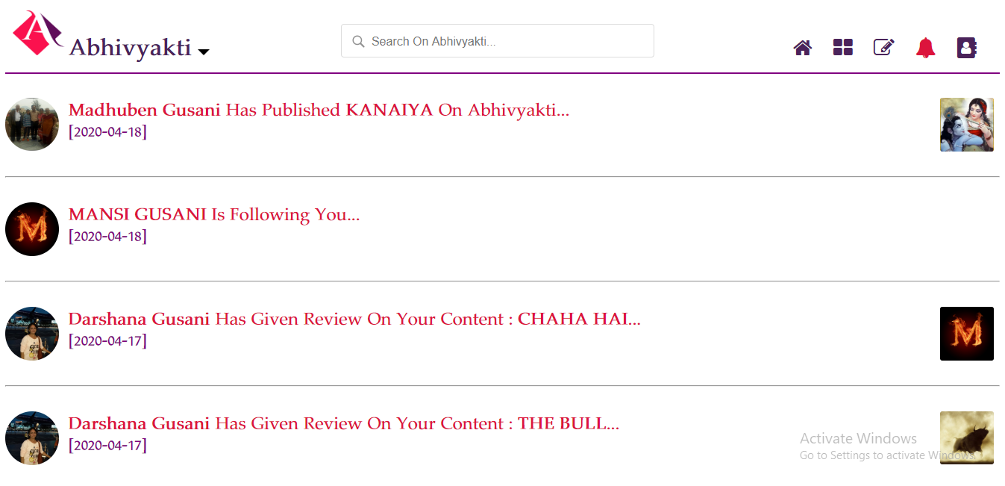
Update – 3

Slide 40
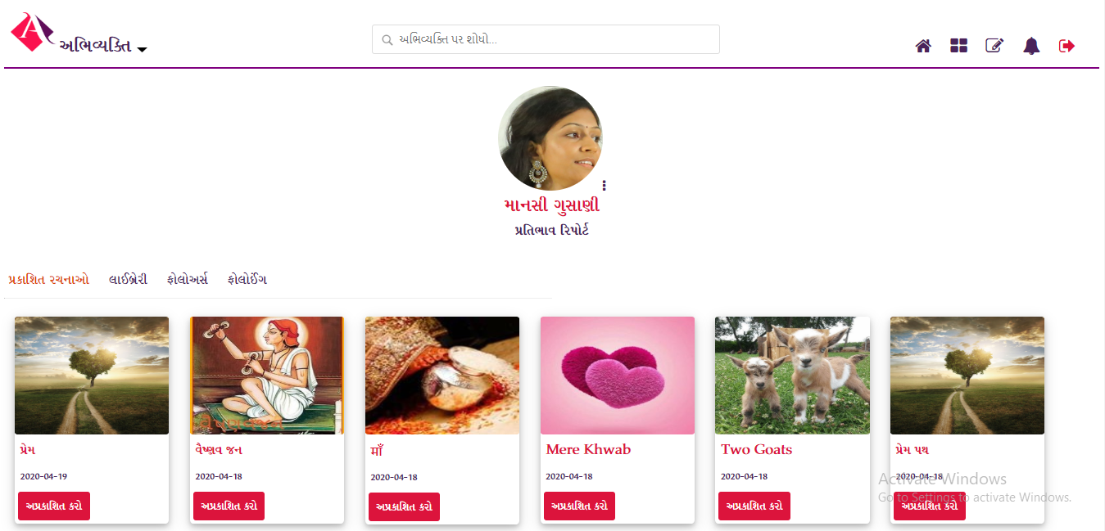
User Profile – 1

Slide 41
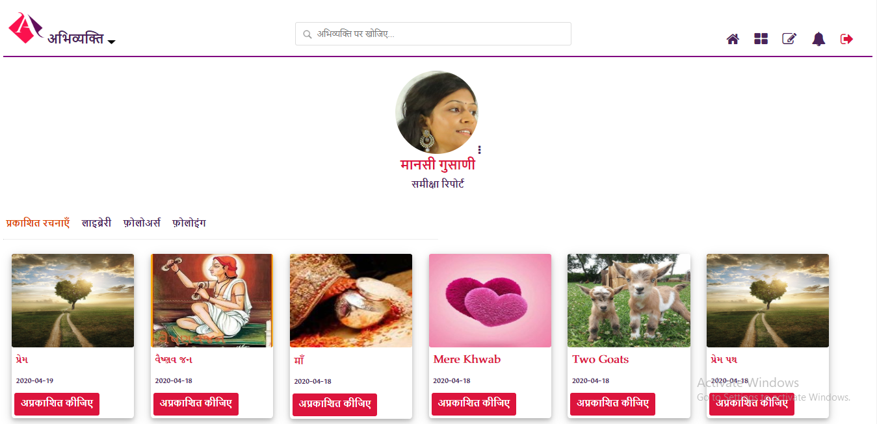
User Profile – 2

Slide 42
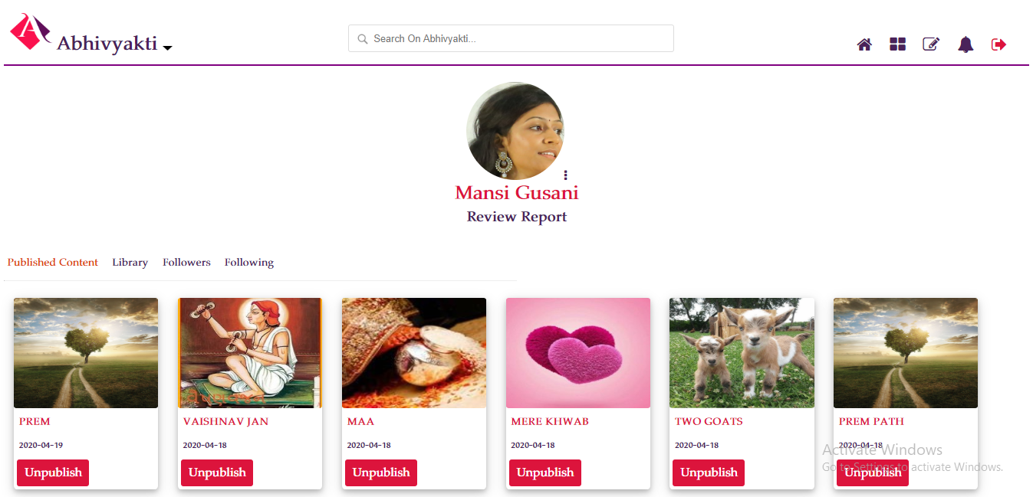
User Profile – 3

Slide 43
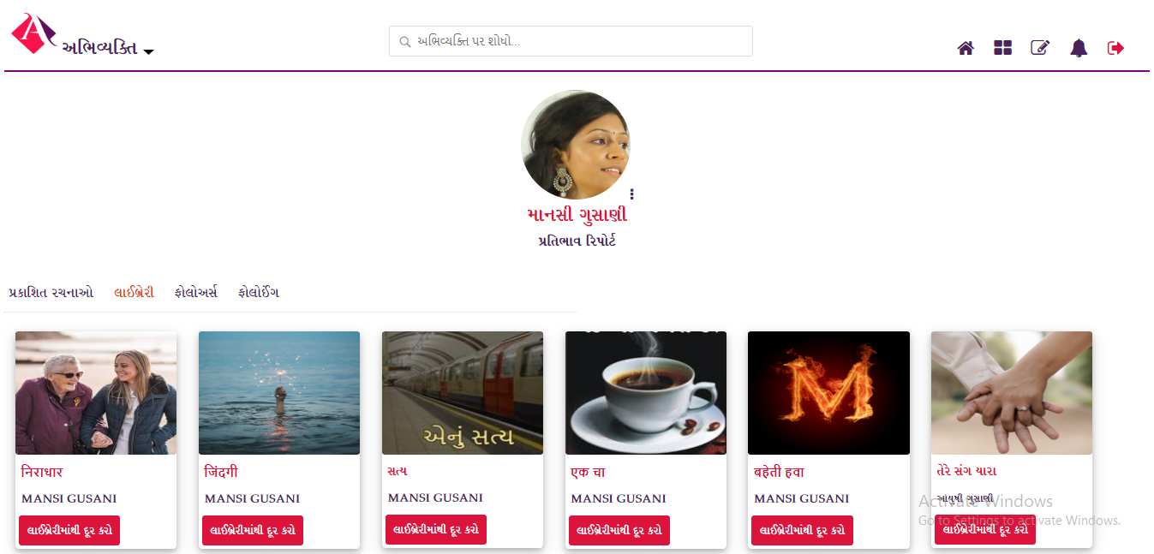
Library – 1

Slide 44
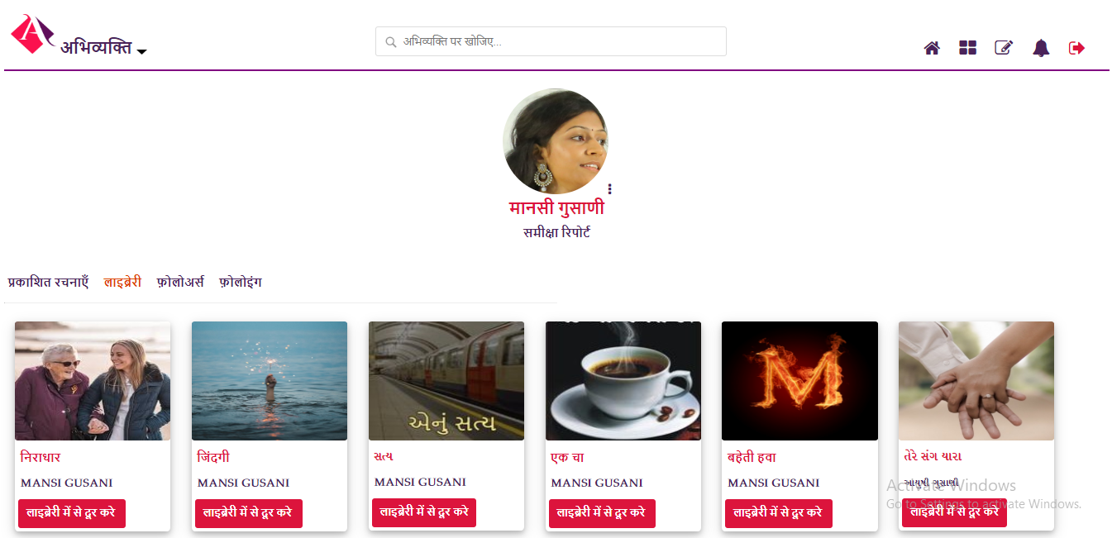
Library – 2

Slide 45
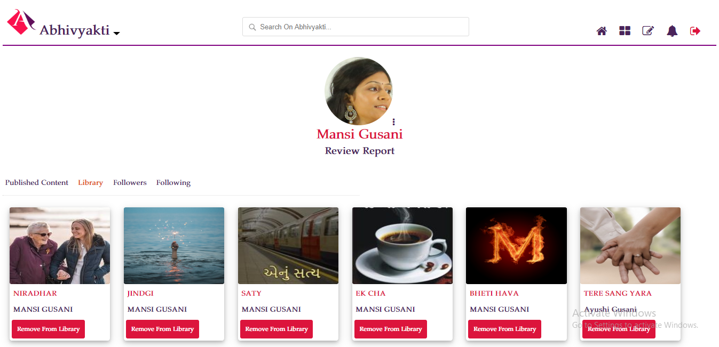
Library – 3

Slide 46
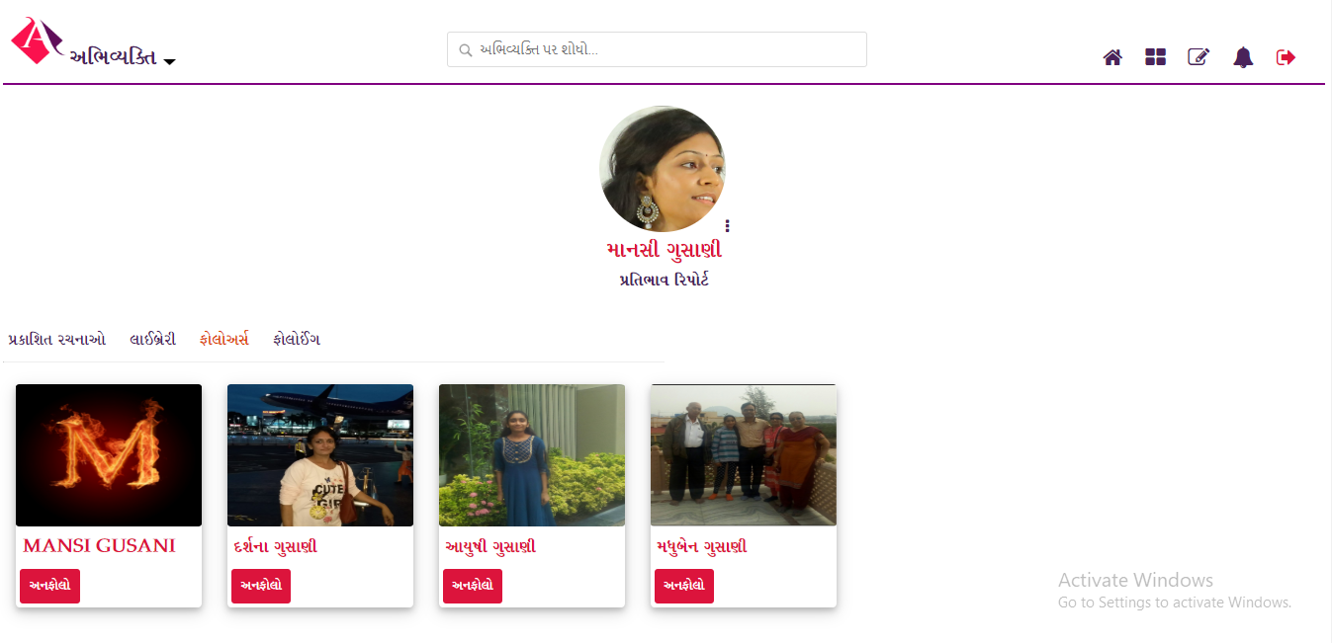
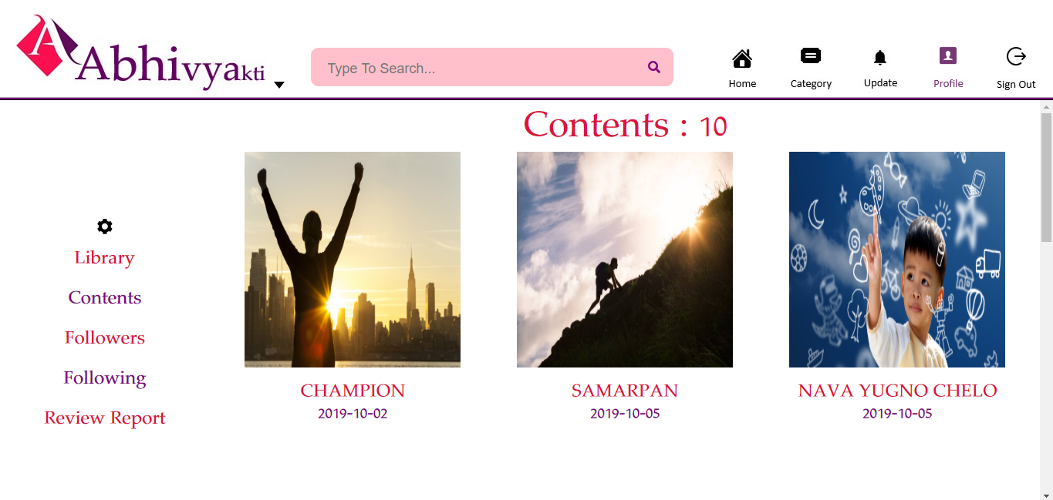
Followers – 1

Slide 47

Followers – 2

Slide 48

Followers – 3

Slide 49
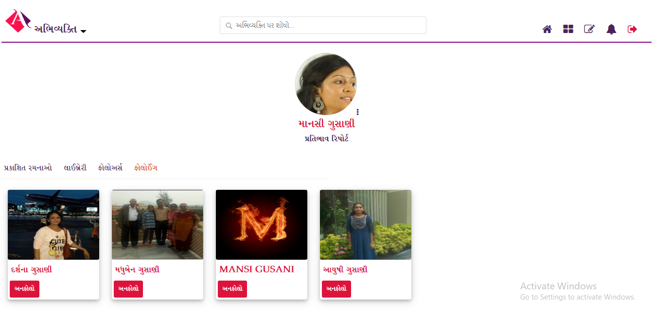
Following – 1

Slide 50
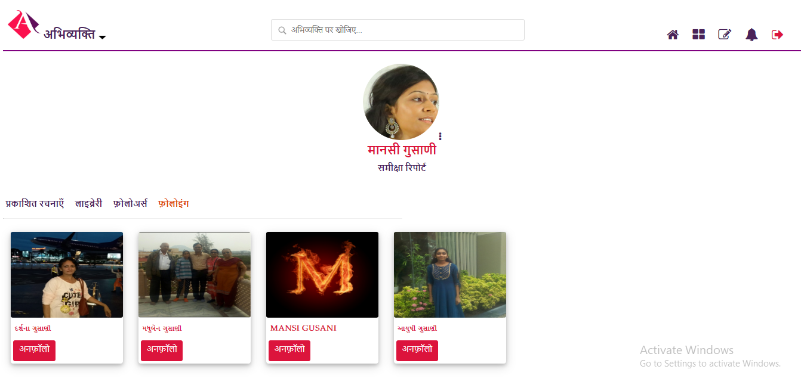
Following – 2

Slide 51

Following – 3

Slide 52
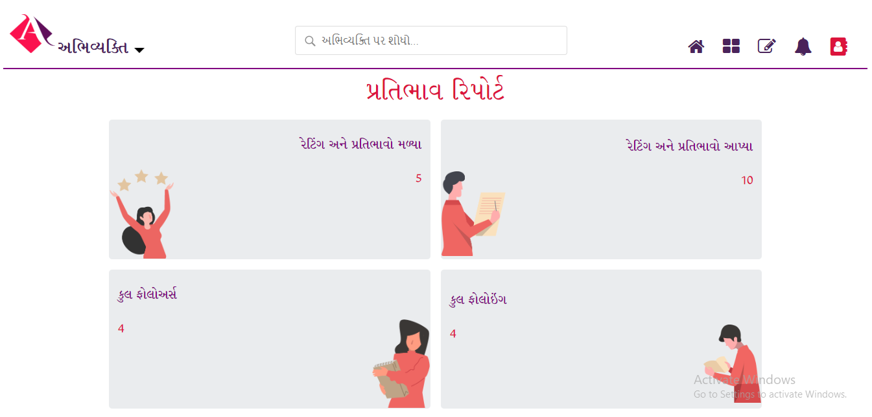
Review Report – 1

Slide 53
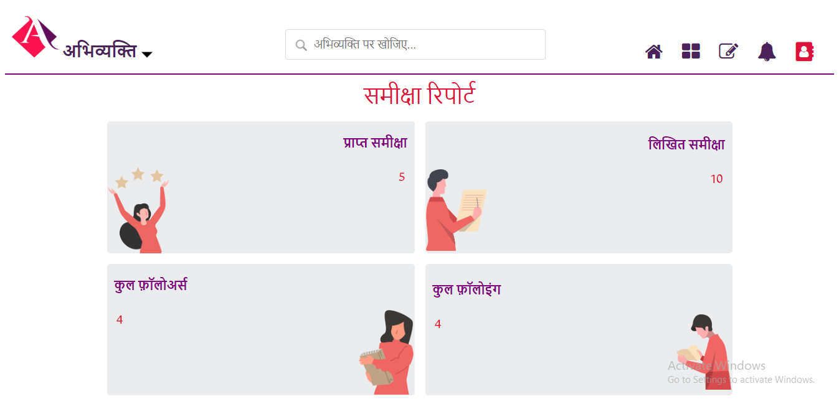
Review Report – 2

Slide 54
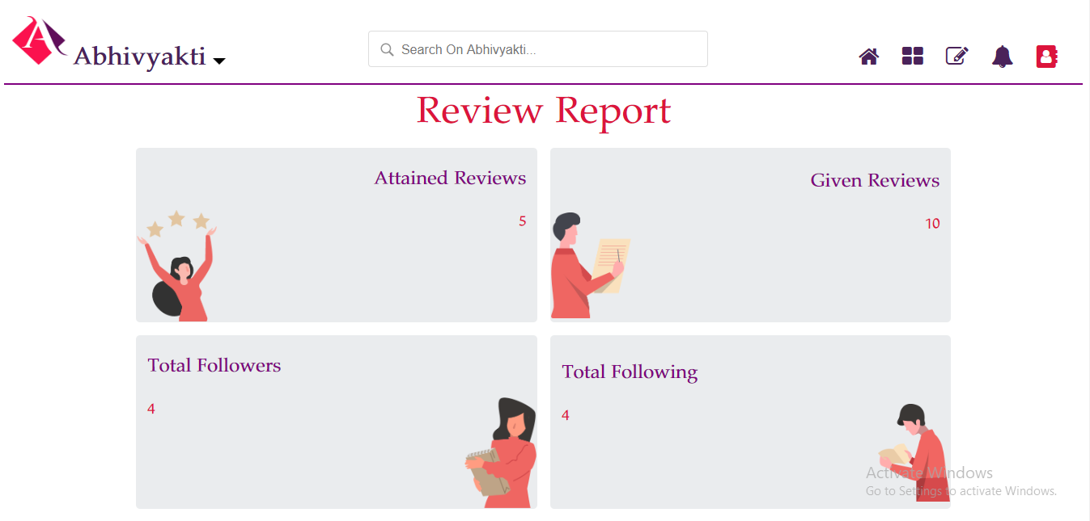
Review Report – 3

Slide 55
conclusion

Slide 56
Here by, I declare my Website titled “Abhivyakti Website” has been completed. I assure to have prepared this project completely by myself without any kind of duplicity and/or copying any material. Hope the effort put by me is useful.
“I have tried my best for developing this Website for user’s convenience and easiness…”

Slide 57
bibliography

Slide 58
Online References:
1. https://www.w3schools.com
2. https://www.w3resource.com
3. https://www.tutorialspoint.com
4. https://www.geeksforgeeks.org
Offline References:
1. PHP And MySQL Web Development – Luke Welling, Laura Thomson – Pearson
2. Julie C Meloni, “Sams Teach Yourself PHP, MYSQL And APACHE All In One”, ‘4th’ Edition – Pearson Education

Slide 59
Thank you…

